Slide 1
Direct Instruction & RTI Programs

Slide 2
Learning Support at ASC
At Aveley Secondary College we support all students to achieve personal excellence with targeted approach to teaching and learning. Our Direct Instruction and Response To Intervention (RTI) provide support for students below benchmark. These programs are evidence-based to accelerate student outcomes.
Tier 3
Tier 2
Tier 1
Extra Curricula –Intensive Class
Direct Instruction
Explicit Direct Instruction
Notes:
RTI uses a 3-tiered prevention model in which students receive increasingly intense interventions based on need, which is identified by assessment data.
Tier I: Explicit Direct Instruction in all classrooms. This instructional practice is our signature pedagogy. It is an evidence-based practice that comprises daily review, lesson design and delivery that promotes academic engagement, makes students accountable for their learning, and moves learning into long-term memory. Key components include clear learning intentions, success criteria, checking for understanding and guided and independent practise in a structured format.
Tier II: Direct Instruction. Connecting Maths Concepts (2 levels) and Corrective Reading Decoding (3 levels). 2019: Essentials for Writing. Parents are notified if their child is in this program.
Evidence-based pedagogy supported by extensive research.
Placement testing.
Scripted lessons with in-built assessment and mastery criterion.
Direct teaching. Skills and strategies presented explicitly.
Teacher modelling and demonstration.
Guided and independent practice and application with corrective feedback.
Brief, frequent practise to ensure mastery of each process or skill.
Material is organised to provide cumulative review of skills.
The amount of new information is controlled and connected to prior learning.
Tier III: Before-school Intensive Program
Students who are already in TIER II Direct Instruction program.
Identified through DI assessment combined with teacher professional judgement.
Capacity of student and family to commit to the program is critical.
10 week commitment (whole term), Thursday mornings 8am to 8.30am.
Invitation by letter, parent consent is required.
Intensive skill remediation and repeated practise.
Parents invited to “graduation”.
Other Notes:
All students receive a primary level of prevention through the teaching of a research-based core pedagogy in the general education classroom. If the primary level of prevention (commonly referred to as Tier I) is effective, the majority of students will be able to maintain appropriate progress and meet academic benchmarks with little to no additional support. This is our guaranteed pedagogy that will occur in all classrooms.
However, it is likely that a percentage of students will require a more intense level of instruction, or a secondary intervention, often labelled Tier II. In Tier II, students who require additional support receive instruction in addition to that offered in Tier I. It is important to note that Tier II supplements Tier I; it does not replace Tier I instruction for students who require more intense interventions. This will occur in classrooms where students with similar learning needs are grouped together to optimise academic engaged time. These students may also be invited to attend before-school learning Academies.
A smaller percentage of students may require an even more intense level of intervention than that offered in Tier II. This tertiary level of prevention, or Tier III, provides more intense support for these students. Instruction may be intensified in terms of content, group size, and duration. Students in Tier III are not able to progress in Tier I and Tier II without additional support. These students will be divided into smaller sub-groups for more intensive teaching support. They will be invited to attend before-school learning academies. Commitment from the student and the family is critical.

Slide 3
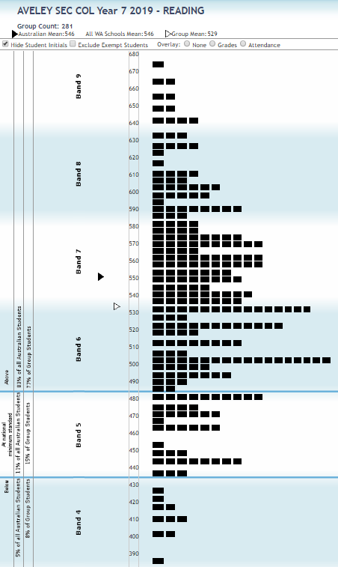
Year 5/7 NAPLAN results show that students behind benchmark will struggle to reach the expected achievement standard (ONLA) by the end of year 12. Our program aims to reduce the number of students in this situation.

Slide 4
Student levels
Many Students in the Direct Instruction Program are currently 1 to 2 years below their year level. Some students are even further behind their peers.
There is a large gap between students above standard and those below standard.
These gaps make it difficult for students to access mainstream curriculum.
These programs work by consolidating basic skills and remediating any missed concepts.
The College aims to have as many students achieve their OLNA as possible by the end of Year 12

Slide 5
English
PATHWAYS

Slide 6
DIRECT INSTRUCTION FOCUS
SRA Corrective Reading (during English lessons)
Helps teachers deliver tightly sequenced, carefully planned lessons that gives students the structure and practice necessary to become skilled, fluent readers.
Teacher modelling and demonstration to boost student confidence and success.
Guided and independent practice and application to gradually transfer responsibility for learning.
Adequate practice and review to develop deep mastery of skill and concepts.
Corrective Reading enables students to improve their literacy to a level where they can engage with mainstream curriculum.

Slide 7
RESPONSE TO INTERVENTION FOCUS – INTENSIVE CLASSES
The intensive classes (before and after school by invitation) aim to improve student’s writing and functional literacy by:
Includes key grammar, punctuation and writing concepts are repeated and reinforced
Providing structures for students to use in their writing
Teaching skills to review and analyse texts and images
What is Functional Literacy?
A functionally literate reader is able to read well enough to operate in society, encompassing the level of literacy that enables a person to be trained in technical or trade courses. Attaining the minimal reading age is critical for a person to adequately function in society. Functional literacy provides the basic skills for a person to find employment and manage their day-to-day living needs.

Slide 8
Benefits
Many students in DI struggle to engage with the texts in the mainstream curriculum because they are too complex for their reading ability. This program helps to improve reading skills to build confidence and mastery in reading decoding.
Engaging in the DI program now will assist your child to engage in the mainstream curriculum with improved reading fluency. Students are working on key skills that they will need to achieve their OLNA (online literacy and numeracy tests – taken from year 10) which will enable them to satisfy the literacy component for WACE.

Slide 9
Pathways in English

Slide 10
mathematics
pathways

Slide 11
Direct Instruction
Students were identified as having limited performance in the area of numeracy on the various metrics, including NAPLAN results. Some students are further behind their expected grade level standard, but all students identified would benefit from embedding core maths skills.
The course requires students to constantly drill core number skills, which form the foundation for their understanding of basic numeracy skills and concepts.
It is intended that through the DI and Intensive classes, that students will gain greater mastery of their numeracy skills.

Slide 12
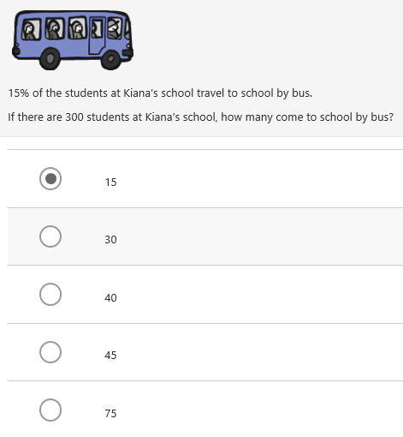
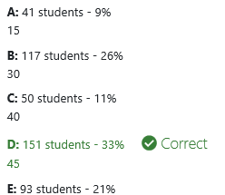
Year 7 PAT
Taken from PAT test 7 taken predominantly by year 7 students, showing expected mastery of basic number skills and reading capacity.

Slide 13
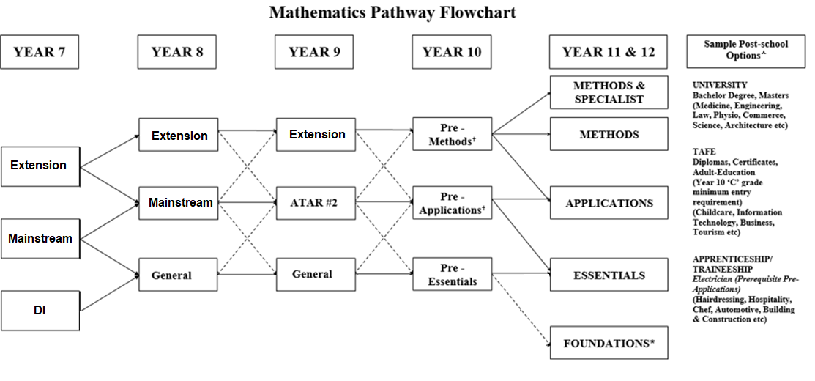
Our BROAD pathways

Slide 14
Questions
Email – Rachael.Ball@education.wa.edu.au

