Slide 1
VET DELIVERED TO SECONDARY STUDENTS (VETDSS)

Slide 2
WHAT YOU NEED BEFORE YOU START YOUR APPLICATION
USI
YEAR 10 REPORT(e.g. PDF); + Western Australia Student Number + OLNA RESULTS
PARENT/GUARDIAN EMAIL ADDRESS AND MOBILE PHONE NUMBER;
RESUME, REFERENCES AND ANY CERTIFICATES WHICH WILL HELP SUPPORT YOUR APPLICATION;
STUDENT STATEMENT OUTLINING WHY YOU SHOULD BE SELECTED TO PARTICIPATE IN THE COURSE (PLEASE NOTE THERE IS A LIMIT OF 1000 CHARACTERS THAT CAN BE ENTERED IN THIS SECTION).

Slide 3
WHAT YOU NEED BEFORE YOU START YOUR APPLICATION
PROOF OF CITIZENSHIP:
o For Australian Citizens - Provide a copy of either your birth certificate, passport or Certificate of Australian citizenship. The copy must include proof of full name.
o For New Zealand Citizens - Provide a copy of your passport. The copy must include proof of full name.
o For Australian permanent residents or humanitarian visa holders - Provide a copy of your passport. The copy must include proof of full name and also visa sub-class number.
o For Citizens other than Australia or New Zealand - Provide a copy of your passport and visa document. The copies must include proof of full name and citizenship.

Slide 4
HOW LONG WILL IT TAKE?
UP TO 30 MINS… SO DON’T LEAVE IT UNTIL THE LAST DAY

Slide 5
WHEN MUST IT BE COMPLETED BY
31 AUGUST DON’T MISS THIS DATE

Slide 6
How to apply
Follow the hyperlink below to access the “how to apply” PDF for North Metro Tafe
How to apply NMT VETDSS courses
Follow the hyperlink below to access the “how to apply” PDF for South Metro Tafe
How to apply SMT VETDSS courses

Slide 7
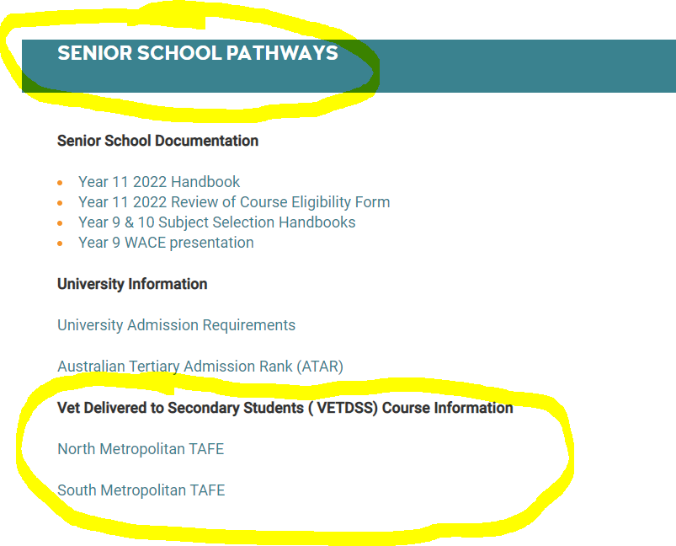
I NEED HELP
COME TO STUDENT SUPPORT (WHERE FIRST AID IS) TO MAKE AN APPT.
OR:

